Slide 1


Claims Processing System
Sun Health and Allied Insurance Case Study
Dated : 07th July 2025
Presented by:
Naveenkumar Kandala
Roopesh Burra
Srigowri N
Simple Solutions!

Slide 2
Agenda :
Company Overview
Product Portfolio
Distribution Network and Financial Information
Insurance Basics – How Is it Calculated
Claims and its Types
Claims Registration and validation
Sum Assured – Covers
Document Check – Fraud check
Deductibles and its types – CoPay
Key benefits – Assumptions
Status code
Simple Solutions!

Slide 3
Company Overview
Sun Health and Allied Insurance, founded in 2006, is a standalone health insurer headquartered in Chennai, India.
Joint venture: Sun Health Investments, ICICI Venture, Sequoia Capital, Oman Insurance Company, and ETA Ascon Group.
India’s first standalone health insurance company, with a pan-India presence and 160+ branches.
Offers cashless hospitalization and reimbursement at 6000+ network hospitals.
Awarded "Claims Service Company of the Year 2014".
Wide range of health insurance products.
24x7 free medical advice and preventive health check-ups.
They also run preventive health check-ups for their customers in promoting good health
Simple Solutions!

Slide 4
Product Portfolio
Health Insurance: Sun Health offers a wide portfolio of health insurance plans, including:
Sun Unique Health
Sun Wedding Gift
Medi Classic
Diabetes Safe
Family Health Optima
Senior Citizen Red Carpet
Super Surplus, Sun Netplus
Sun Health Gain and Sun Criticare Plus
Sun Health Red Carpet is specially designed for senior citizens aged between 60-69 years and provides Sum Assured with a maximum limit of Rs 5 lakhs.
Travel Insurance
Accident Cover
Simple Solutions!

Slide 5
Distribution Network and Financial Information
60 branches across India, expanding to 200.
Most plans available for online purchase.
Premium earned (H1 FY2010): Rs 3,868 million.
Profit before tax (H1 FY2010): Rs 320 million.
Claims settlement ratio (2013-14): 69%.
Simple Solutions!

Slide 6
Insurance Basics
Insurance is a way to protect yourself or your property from unexpected losses, such as accidents, illness, or theft. When you buy insurance, you pay regular amounts called premiums to the insurance company. If something happens that your policy covers, the insurance company will pay for your loss. If nothing happens, your premiums are combined with those of other customers to help cover future claims. This system helps people manage risks and gives peace of mind in case of emergencies.
How is it calculated?
Premiums are calculated based on how likely it is that a claim will be made. Insurers look at general risk factors, such as how often people in a group might make a claim, and personal risk factors, like your age, health, lifestyle, and insurance history. If you are considered higher risk—such as having a medical condition or a risky job—your premium will be higher. The amount of coverage you choose and the length of your policy also affect the cost. Only a portion of policyholders make claims each year, so premiums from everyone are pooled to cover those costs
Simple Solutions!

Slide 7
Health Insurance Claims
Covers medical and surgical expenses.
Provider: hospital, clinic, doctor, pharmacy, etc.
Insured: person covered by the policy.
Types of Claims
Cashless Claims:
Insured gets treatment at a network hospital; insurer pays directly. Reimbursement Claims:
Insured pays upfront at a non-network hospital and claims reimbursement.
Simple Solutions!

Slide 8
Cashless Claims Process
Customer approaches network hospital with the ID card.
Hospital verifies details and sends pre-authorization to insurer.
A field doctor is been assigned to make it easier.
Insurer checks policy and responds with approval, denial, or query.
Hospital admits patient and provides cashless treatment if approved.
Non-medical expenses and co-payment are paid by patient before discharge.
Simple Solutions!

Slide 9
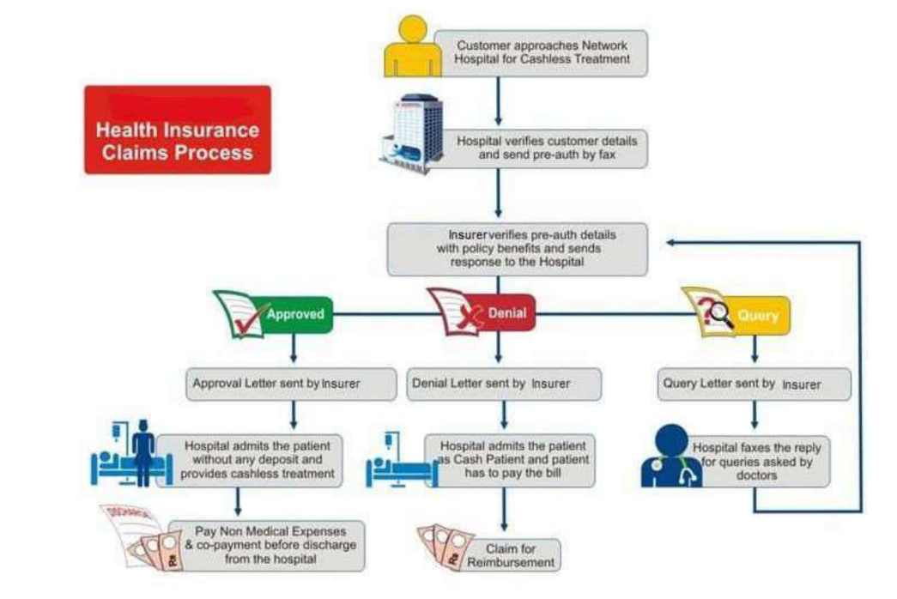
Cashless Claims Process
Simple Solutions!

Slide 10
Reimbursement Claims Process
Customer approaches non-network hospital and pays bills.
Receives all the hospital bills and documents on treatment undergone.
Submits claim documents to insurer.
Insurer reviews and responds with approval, repudiation, or query.
Upon approval, payment and discharge voucher are sent to customer.
Simple Solutions!

Slide 11
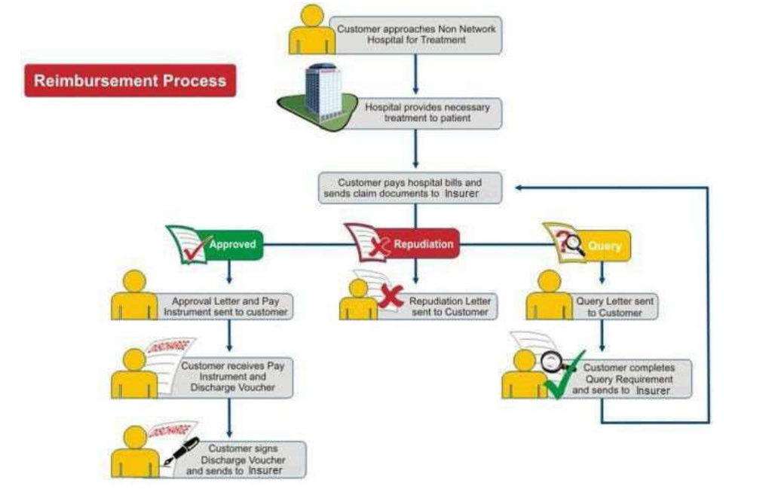
Reimbursement Claims Process
Simple Solutions!

Slide 12
Claim Registration
When the filled-in claim form is received by the insurance company, it is immediately assigned a unique claim number—even if some basic information is missing.
No claim form is discarded without being registered and given a claim number, as required by regulatory authorities like the Insurance Regulatory and Development Authority (IRDA) in India.
The claim number is communicated to the claimant, who must use it for all future correspondence and tracking with the insurer.
All claims—whether received, settled, repudiated, closed, or outstanding—must be transparently reported to regulatory authorities.
It is important to submit accurate information and all required documents during registration to avoid delays or complications in the claim process
Simple Solutions!

Slide 13
Claim Validation
After registration, the insurer reviews the claim to ensure it meets all policy terms and conditions.
Validation includes checking the claimant’s eligibility, policy coverage, sum assured, and whether the claim falls within the policy period.
The insurer verifies that all submitted documents are accurate and complete, and may contact the claimant for clarification or additional information if needed.
Common checks include ensuring the claim is not for excluded treatments, is within the allowed time period, and that the correct cover was selected.
If any errors, missing information, or suspicious details are found, the insurer may request further documents, investigate further, or reject the claim
Simple Solutions!

Slide 14
Sum Assured
The sum assured is the maximum amount the insurer agrees to pay to the policyholder or their nominee if a covered event occurs during the policy period.
In health insurance, this represents the upper limit of what can be claimed for medical expenses under the policy.
The sum assured is chosen at the time of buying the policy and remains fixed unless the policyholder opts for changes or additional covers.
If a claim amount exceeds the sum assured, the insurer will only pay up to the sum assured limit.
After a claim is paid, the sum assured is reduced by the paid amount; to restore it, the policyholder may need to pay an extra premium.
Choosing the right sum assured is important, as it determines the level of financial protection and the premium amount
Simple Solutions!

Slide 15
Common covers in health insurance include
Hospitalization expenses
Day care procedures
Critical illness cover
Accident and emergency care
Death benefit
Domiciliary hospitalization
ICU and surgical cover
Pre- and post-hospitalization expenses
Room rent
Alternative treatments
Pre-existing diseases (if disclosed and covered)
Simple Solutions!

Slide 16
Documentation Check
All claims must be supported by original documents specific to the ailment or treatment.
If the required documents are not submitted within the stipulated time after claim notification, the claim will not be settled.
Proper documentation is essential for smooth claim processing and approval.
Fraud Check
Insurance companies conduct manual fraud checks by sending their physicians or medical practitioners to verify the ailment and treatment.
This process helps prevent fraudulent claims and ensures the hospital and policyholder are not colluding to make false claims.
If a claim is found to be fraudulent, the policy may be cancelled and the hospital may be removed from the insurer’s network.
Simple Solutions!

Slide 17
Payment and Deductibles in Health Insurance
Once a claim is approved, the insurer processes the payment according to the policy terms.
The final claim amount may be reduced by deductibles and co-payments, as agreed upon in the policy.
Payment is made either directly to the hospital (for cashless claims) or reimbursed to the policyholder (for reimbursement claims).
The insurer ensures all conditions, such as deductibles, co-pay, and coverage limits, are applied before settling the claim.
What is a Deductible?
A deductible is a fixed amount that the policyholder must pay out of their own pocket for medical expenses before the insurance company starts covering the remaining costs.
For example, if your deductible is ₹20,000 and your hospital bill is ₹1,20,000, you pay the first ₹20,000, and the insurer pays the remaining ₹1,00,000.
If your expenses are less than the deductible (e.g., a ₹15,000 bill with a ₹20,000 deductible), you pay the entire amount and cannot claim from the insurer.
Simple Solutions!

Slide 18
Types of Deductibles
Compulsory Deductible: Set by the insurer and must be paid for every claim. It does not affect your premium.
Voluntary Deductible: Chosen by the policyholder to lower their premium. You agree to pay a higher out-of-pocket amount when making a claim.
Out-of-Network Hospital Deductible: Applied when you get treatment at a non-network hospital. A certain amount is deducted from your claim to cover the insurer’s extra verification costs.
Cumulative Deductible: Usually applies to family floater plans, where the total deductible is shared among all insured members
Simple Solutions!

Slide 19
Why Deductibles Matter?
Deductibles help reduce your insurance premium—choosing a higher deductible means you pay less premium.
They discourage small or frequent claims, ensuring insurance is used for significant expenses.
Deductibles are not subtracted from your policy’s sum assured; they are separate out-of-pocket costs
CoPay:
CoPay is a fixed percentage of the claim amount that the policyholder must pay, and the insurer pays the rest.
For example, with a 20% co-pay, after deductibles are applied, you pay 20% of the remaining bill, and the insurer pays 80%.
Not all expenses (such as certain fees or room rent) may be subject to co-pay, as specified in the policy.
Simple Solutions!

Slide 20
Key Benefits of CPS:
Cost Reduction: Lower claims management costs through automation.
Faster Processing: Shorten turnaround time and reduce claim backlogs.
Productivity Boost: Improve efficiency by 15–50%.
Fraud Prevention: Detect and block fraudulent claims using advanced checks.
Regulatory Compliance: Ensure adherence to IRDA and other regulations.
Data-Driven Insights: Analyze claims data to calculate performance benchmarks and improve decision-making.
Business Growth: Attract new customers with streamlined, transparent processes.
Simple Solutions!

Slide 21
Assumptions
Scope: Focuses only on individual health insurance (excludes family, floater, and accident policies).
Exclusions:
Renewal policies and historical policy data are not considered.
Reinsurance and coinsurance arrangements are excluded.
Premiums: All premiums are assumed to be paid and up-to-date.
Simple Solutions!

Slide 22
Domain Values (Claim Statuses)
APPROVED: Claim validated and approved for payment.
CLS: Claim closed after settlement.
DOCCHK: Documentation check in progress.
FRDCHK: Fraud investigation ongoing.
PAID: Payment completed.
REGD: Claim registered but not yet processed.
REJ: Claim rejected due to policy violations.
STAPP: Sent for higher-level approval.
VALID: Claim verified and ready for processing.
Simple Solutions!

Slide 23
Actors:
Customer - Policy holder
Insurance coordinator - Policy provider
Medical Validater
Claim Processing Officer
Country head / Regional Manager
Admin
Simple Solutions!

Slide 24
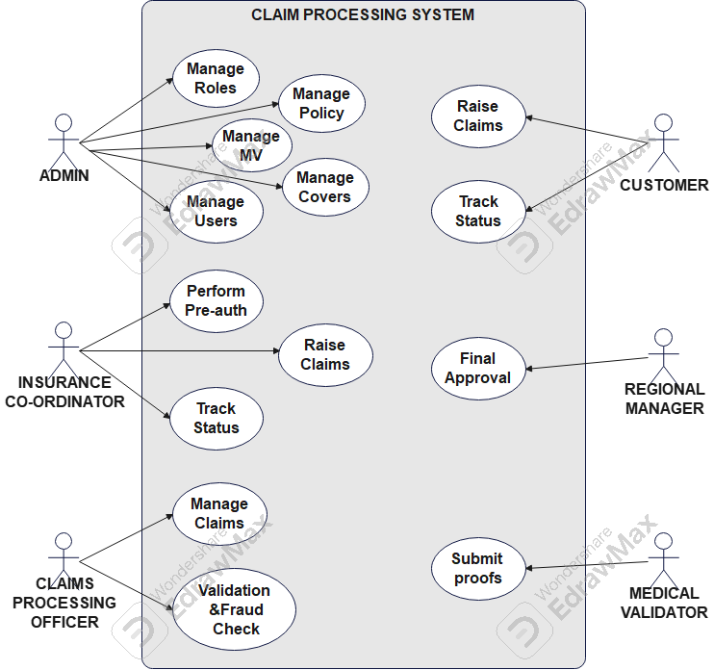
Use Case Diagram:
Simple Solutions!

Slide 25

Database Diagram:
Simple Solutions!

Slide 26
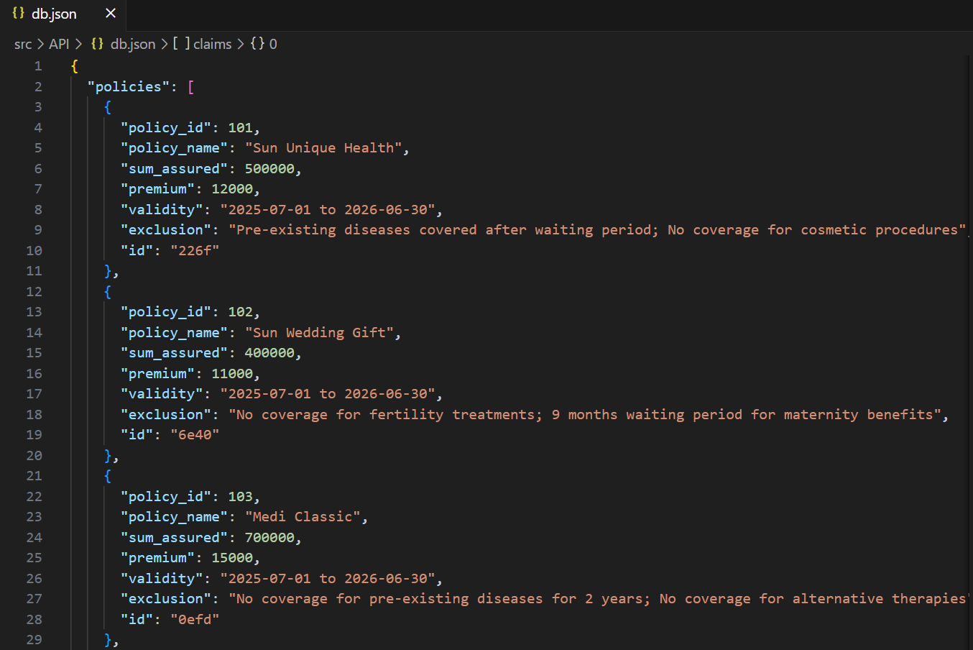
Database Structure:
Simple Solutions!

Slide 27
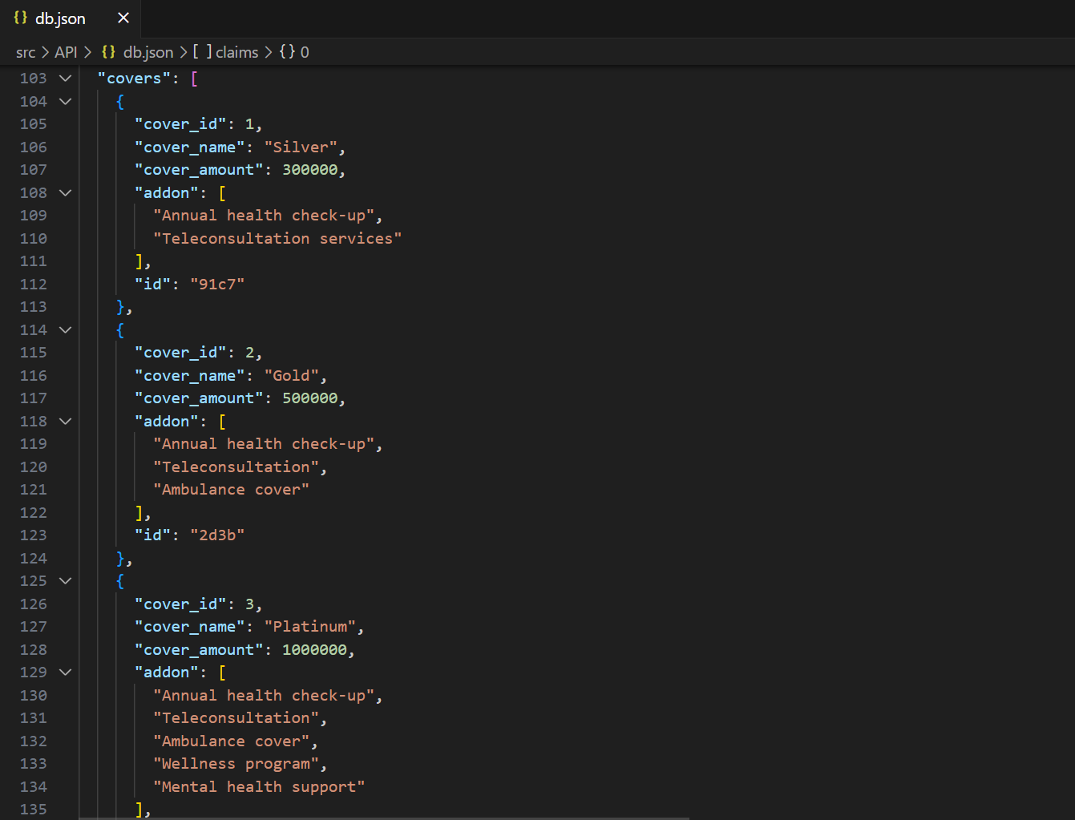
Simple Solutions!

Slide 28
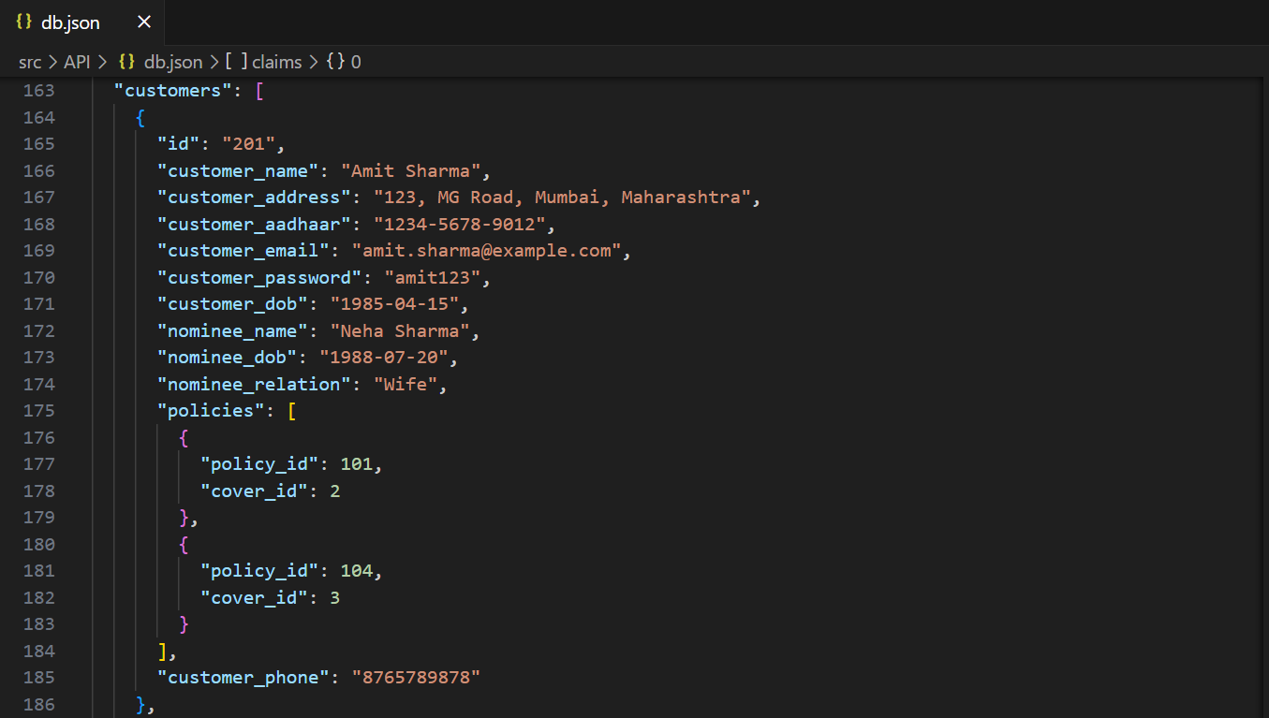
Simple Solutions!

Slide 29
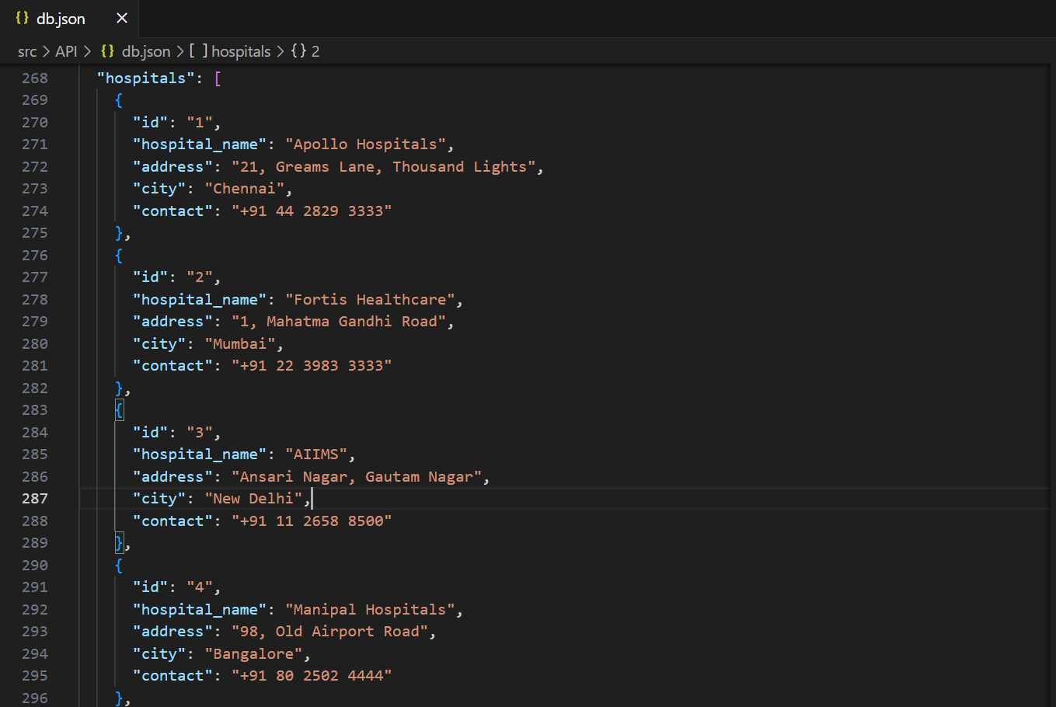
Simple Solutions!

Slide 30
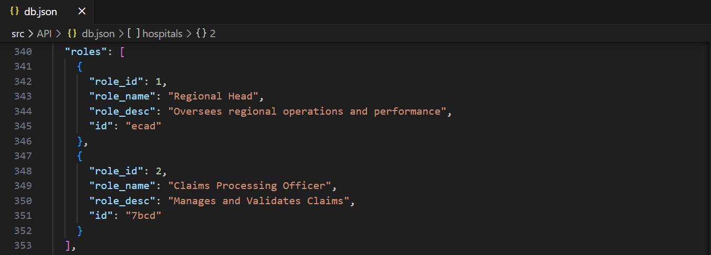
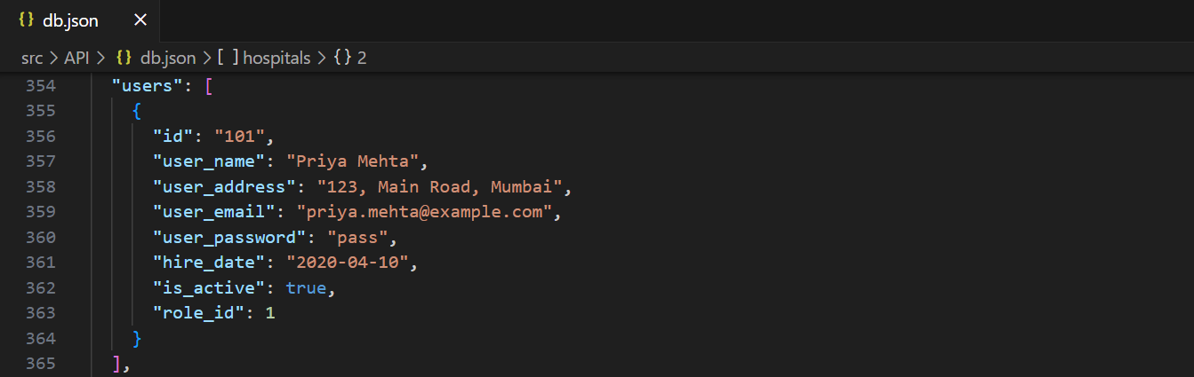
Simple Solutions!

Slide 31
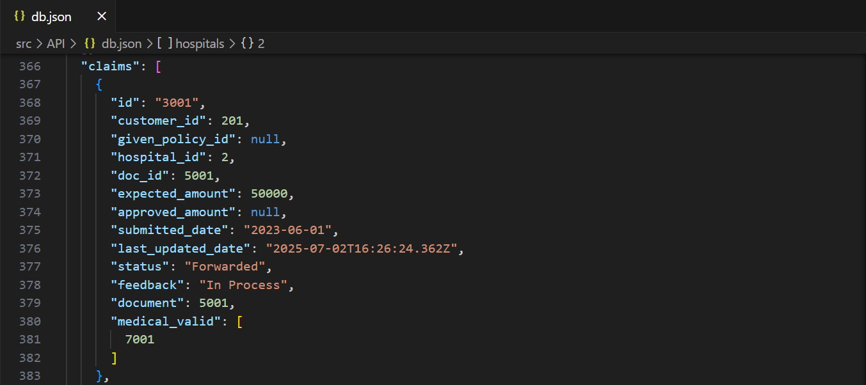

Simple Solutions!

Slide 32
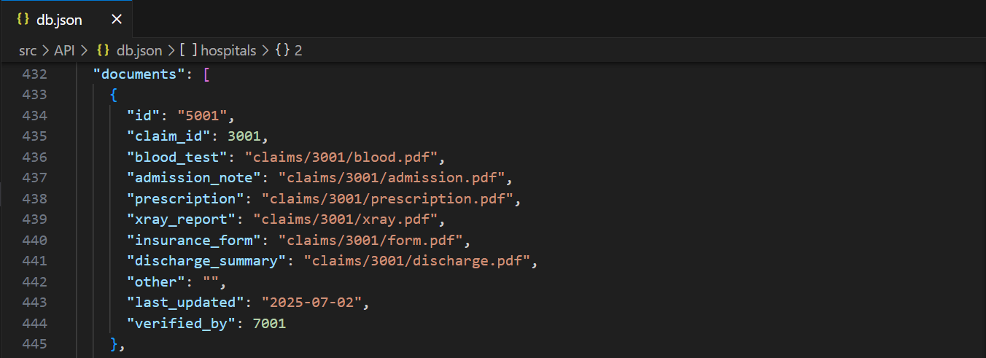
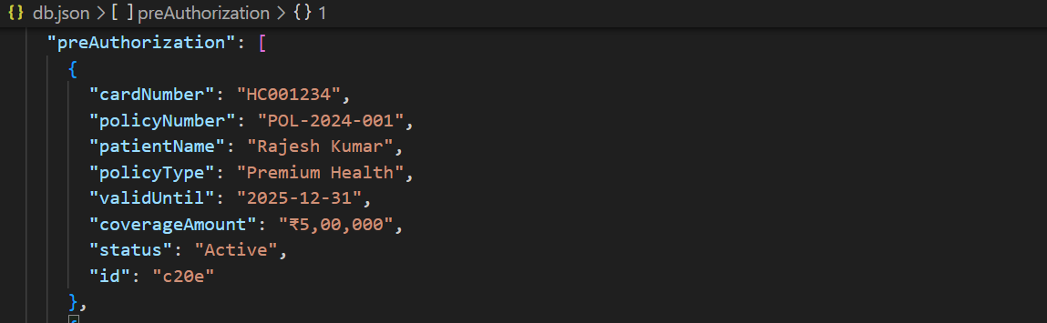
Simple Solutions!

Slide 33
Thank you..
Simple Solutions!

